Slide 1
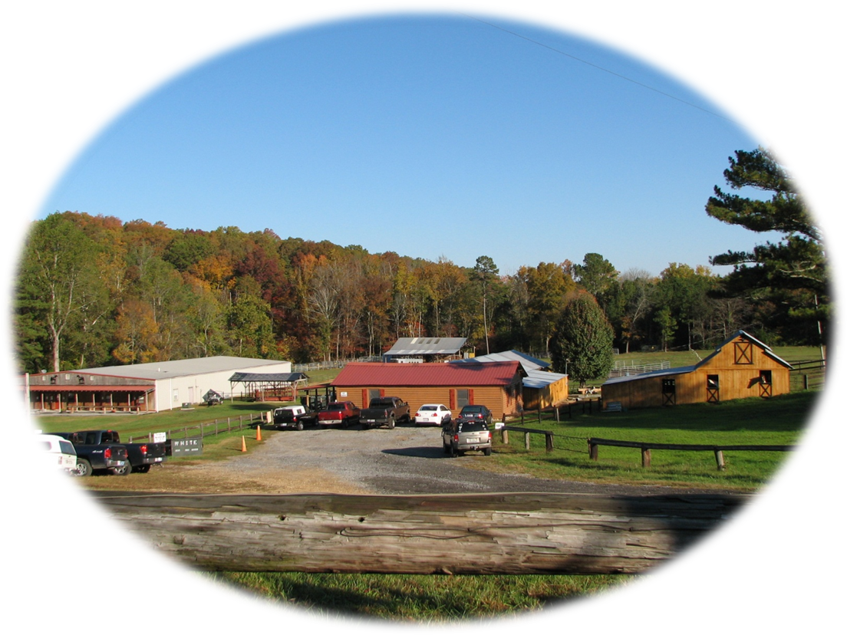
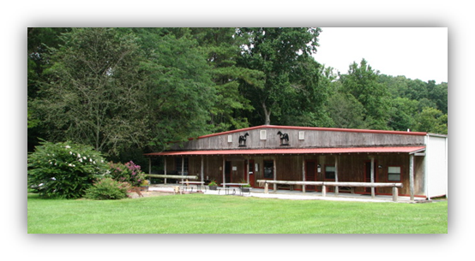
Casey & Son
HORSESHOEING
SCHOOL
& Farriers’ National Research Center
Est. in 1989 Now Proudly Celebrating 30 Years in 2019 !
#1 In The World ! Why???

Slide 2
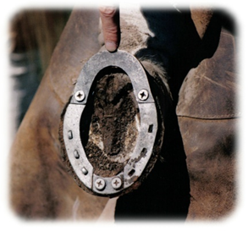
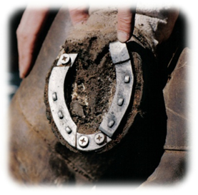
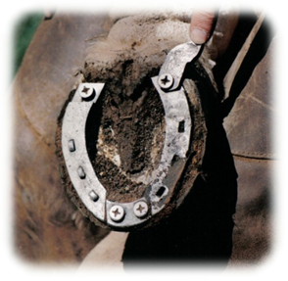
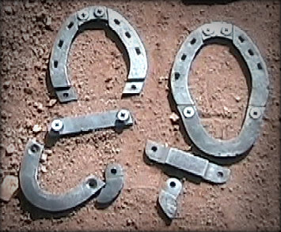
2
Why is our school #1 in the World? We Care about your success !!
Our School has been pioneering new methods and research for 29 years. We offer training that can't be found anywhere else.
The Farrier Science That
Makes The Difference is $$
Our Adjustable Shoe Invented HERE!
Used as an educational aid to study gait and motion of the horse. With just one application of the shoe on the hoof, it can be altered in various ways liked corrective shoes that affect the motion of the horse.
This gives great insight for the student.
Found NOWHERE else in the world!
The more you learn, the more you’ll EARN $$$

Slide 3
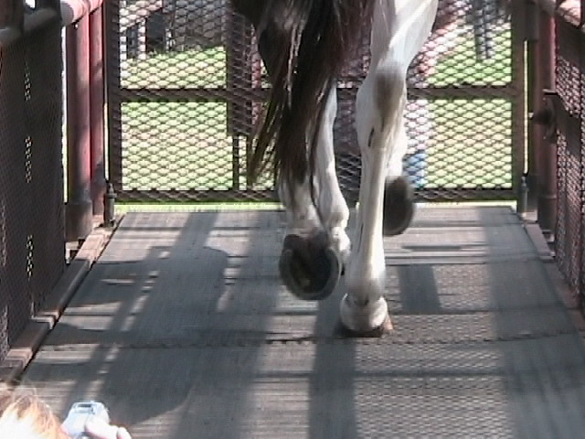
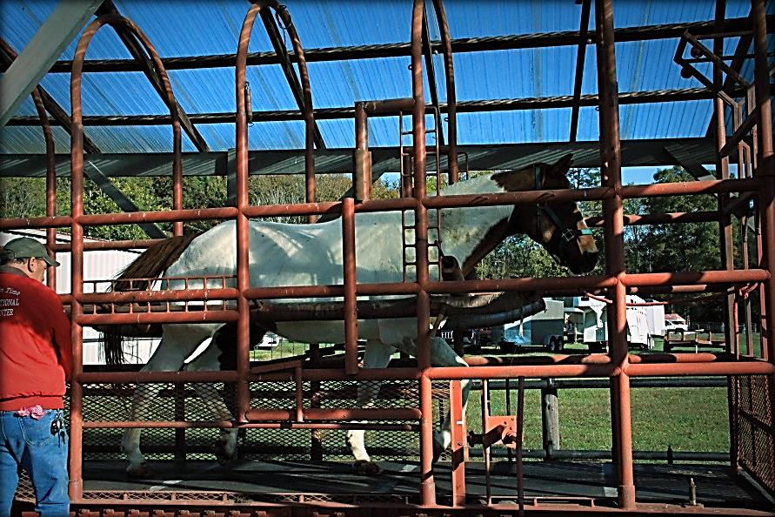
Our Treadmill
3
Our students have the exclusive advantage of seeing the horse in motion with OUR PATENTED Treadmill,
Before, during and after shoeing.
It's not enough to learn how to apply a shoe.
You must learn how the shoe affects motion.
Did you know? There are over 1,000 different types of shoes !
The farrier who knows more, earns more!!!
No other school offers this!

Slide 4
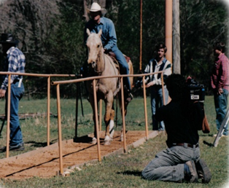
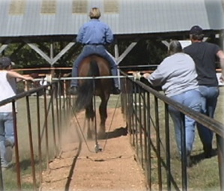
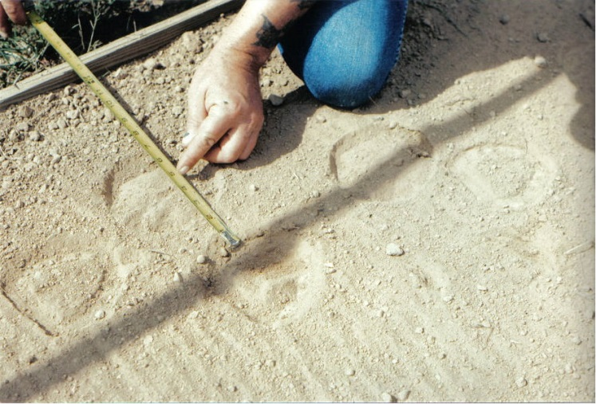
Our CaseyCam And Track
Can ONLY Be Found At OUR SCHOOL!
The Track Was Invented Here In 1989.
4
The CaseyCam and Track
CNN Interview
1992
The CaseyCam and Track revised
2008
Filming and reviewing footage in slow motion allows you to see what the eye cannot!
You’ll learn more than many
seasoned farriers ever learn!
Be in demand. Make more $$$!
Using the Adjustable Shoe on the Track to analyze foot impressions.

Slide 5
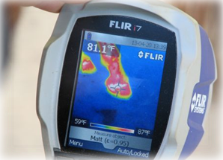
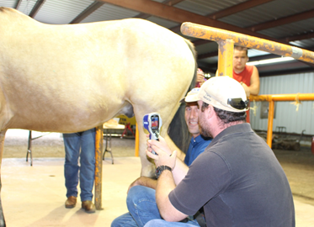
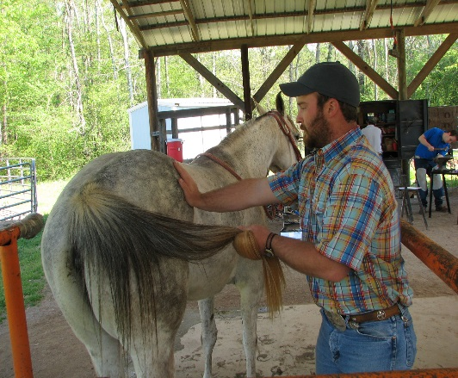
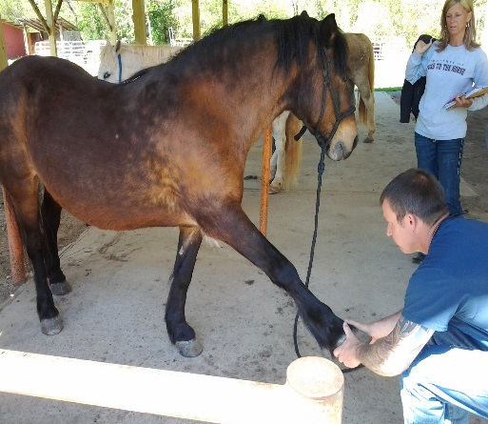
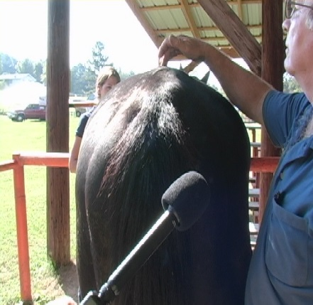
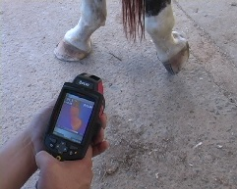
Be ahead of the curve with
Thermal Imaging Cameras available here
Learn the Advantages Of Using Modern Technology.
Quick, Easy and Informative with the click of a button.
We have combined Thermography with shoeing.
The Condition of the Whole Horse will have effects on the hooves !
5
Infrared Thermal Imaging
2011
Infrared Thermal Imaging
2017
Equine Flexion Therapy - EFT
Is included in our 12 week and 6 week advanced
Only offered at this school ! Learning the anatomy this way will help the horse first while you, the Farrier, improve your horsemanship skills and knowledge on how to explain it with the owner while
still staying safe !

Slide 6
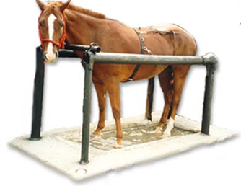
6
Our Soaking Tank
A valuable tool for the Farrier to address such problems as:
Founder
Abscesses
Lameness
It allows us to study diseases and to understand how the use of various soaking solutions can affect the horse’s hooves.
Soaking Tank
1992
“To keep the bony column of the leg in alignment wherein when the foot strikes the ground, the entire bony column, including the spine, equally absorbs the concussion.”
DVD
“Our Grammar School of Trimming & Shoeing Horses”
The benefits of Our DVD helps explain the question for the beginner & owner:
What IS that Farrier Doing ??
Our Six Steps explains it well
It is Simple to Understand !!
Learn Faster & Easier! Hands ON !
Less classroom, more conversation.
Enjoy your training !!
Hard work, but rewarding !
Become A
Well Trained, Well Paid
Professional In Less Time !
Time Spent Well and Efficiently !

Slide 7
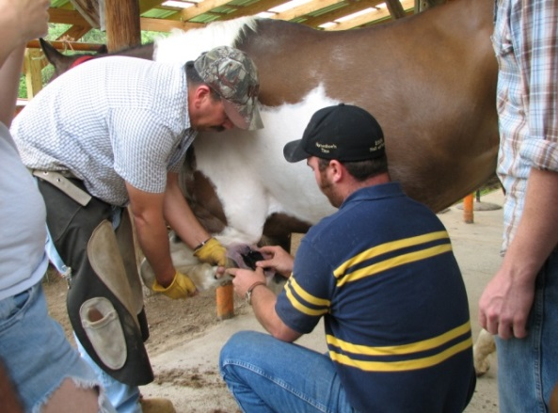
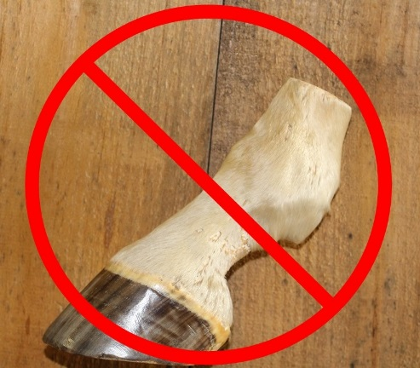
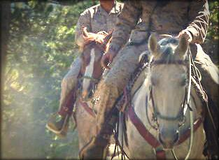
We never SHOE Cadaver Horses Hooves !
7
100% All Hands-on with Live Horses Here !!
Different horses every day provided by horse owners !
Small Classes allowing plenty of time to evaluate the whole horse !
We do have access to a variety of freeze dried legs & hoof models to aid in exploring the interior of the horses limbs as part of our classroom/library.
Our school was specially selected by the
U. S. Department of Defense
to train the #1 Special Forces Team in the World..
Special Forces
Proving once again that Our School Is
#1 IN THE WORLD!
Special Forces team learning how to handle, pack, ride horses & about hoof care in rough terrain similar to overseas.

Slide 8
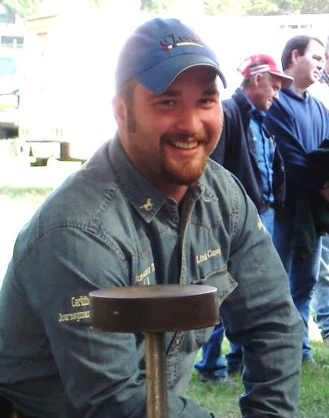
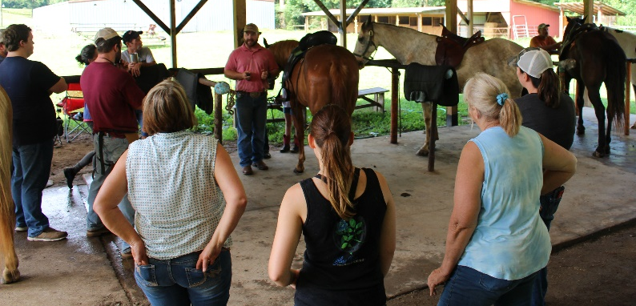
8
Our Staff
Each of our instructors has a working knowledge of the specialized topics they teach, sharing insights gained through many years of professional experience.
Link Casey, (son) School Owner & Head Instructor
2rd Generation Certified Master Farrier
BWFA Master Educator & President
BWFA Hall of Fame Inductee, 2005
“Choosing the right school, whether it is near you or far away, can be
the difference in success or failure.”
–Link Casey
Guest Farriers : Once or twice a month, one or more guest Professional Farriers of all ages will come in to teach their specialties in shoeing, forge-work and business related to the current Farrier and Horse Industry.
Clinics for Horse Owners and Farriers are scheduled several times a year.
Dan Marcum, Texas
Certified Master Farrier, Equine Adjuster, Professional Horseman and Showman, BWFA Hall of Fame Inductee, 2012
Equine Flexion Therapy (EFT) is a patented technique by our Instructor, Dan Marcum who brings 32 years of farrier experience and expertise to our program. This helps our students understand the anatomy of the “whole horse,” muscles, tendons, how they flex and affect the soundness of the horse in motion. His three day course is included in the 12 week and 6 week advanced courses.

Slide 9
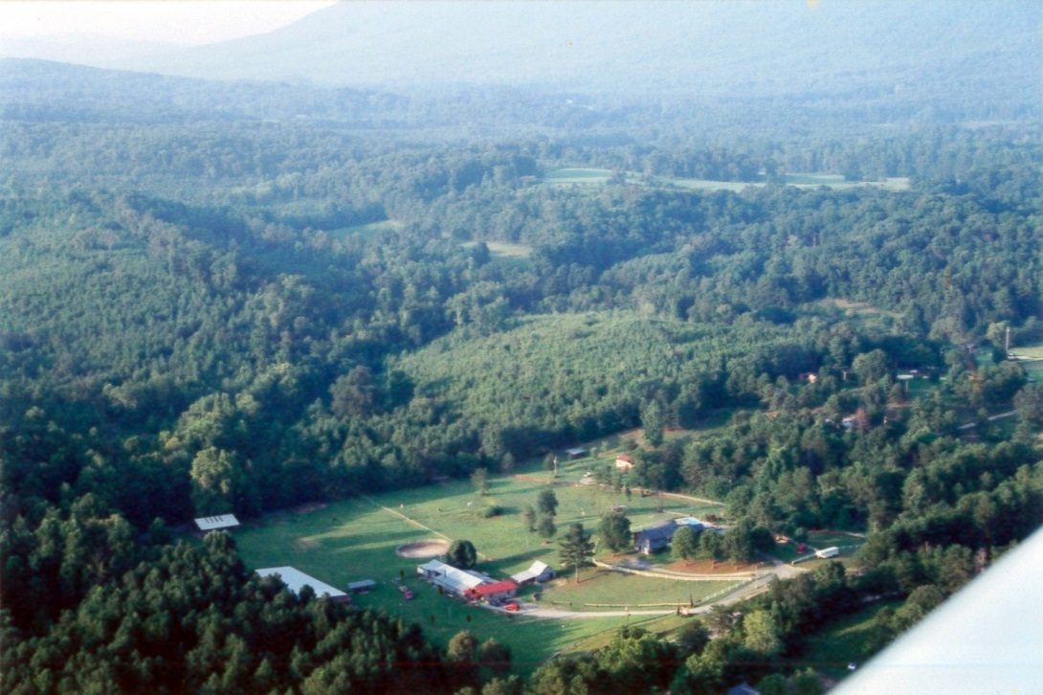
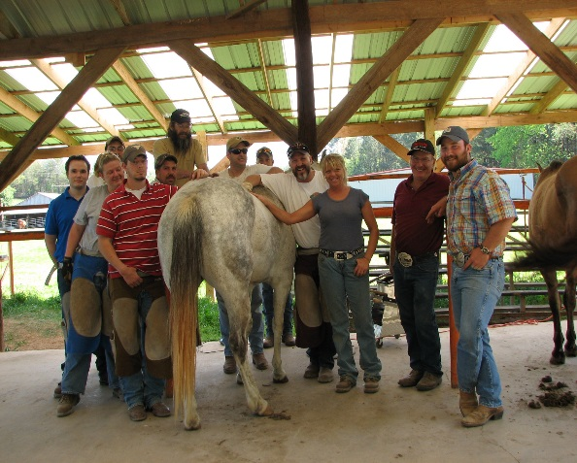
Stay with us, and feel like home…
9
Nestled in the Chattahoochee National Forest of Northwest Georgia, we are located in the friendly community of Villanow. Fishing lakes, trout streams, walking and riding trails and national parks are all within a 10 mile radius of the school. Dalton and Calhoun, Georgia are located less than 15 miles away. We are located 65 miles north of Atlanta, GA and 35 miles south of Chattanooga, TN, with easy access from I-75.
Our Goal: The blacksmith and farrier craft is one of civilizations oldest professions still in demand today. The farrier craft requires a high degree of knowledge and skill. The highest demand and income potential is for the farrier who is well educated and properly trained, and has professional credentials. It is also necessary to keep abreast of new technology and techniques. This school was started with these goals in mind. We offer a well-designed educational program using the most current equipment to meet this demand.
Our Objectives: Statistics show that over 79% of all horse problems will occur from the knee down. Most of these problems fall directly in the realm of the horseshoers influence. The school’s primary objective is to teach the importance of hoof care, trimming and shoeing for horse owners, then they will seek out better farriers …. and offer the best farrier training available for someone desiring to become a professional farrier and self employment.
Farrier Certification You will be offered the opportunity to take a certification test provided by the Brotherhood of Working Farriers Association, Inc. We are a testing facility for students and outside farriers.
The BWFA will allow graduate students from a six week or more school to receive the Apprentice II Certification level upon successfully graduation.
Your annual dues are paid directly to the BWFA and not to the school and it IS NOT part of your tuition payments. This school does not charge any additional fees for taking the test.
We highly recommend that all six and twelve week students apply for farrier certification to begin their professional farrier career.
Job Assistance
Our office and the BWFA National Farrier Referral Program will help you locate another BWFA farrier to work with in your area as an apprentice if you choose.
This may help you gain more experience and customers as a new farrier. Attending clinics to meet farriers is highly suggested as ongoing continuing education.

Slide 10
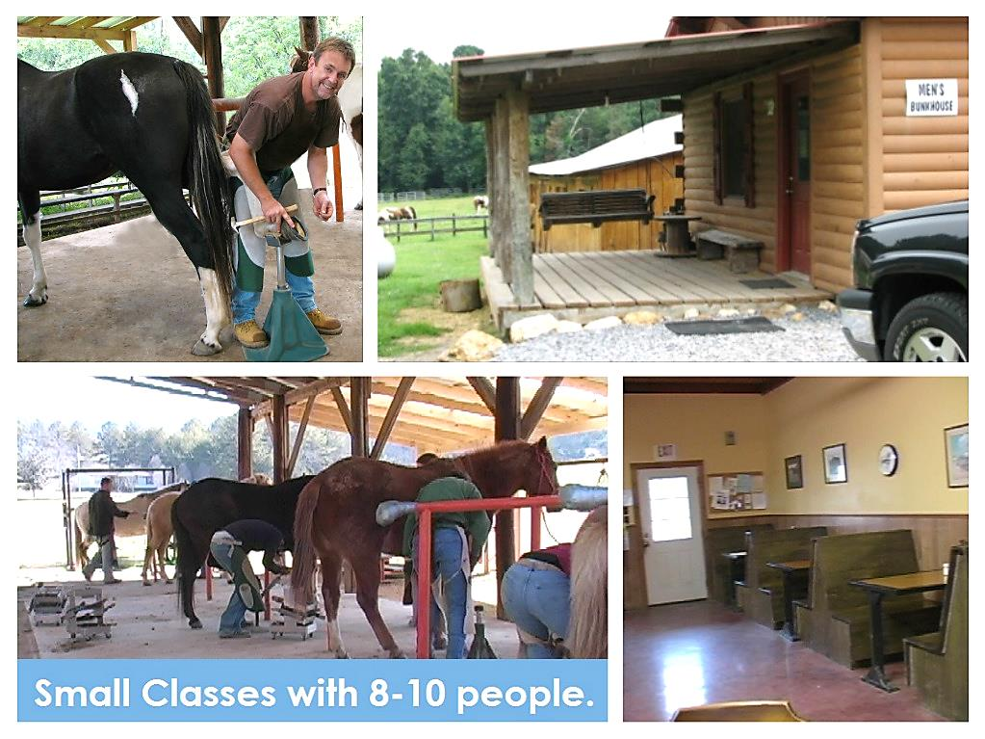
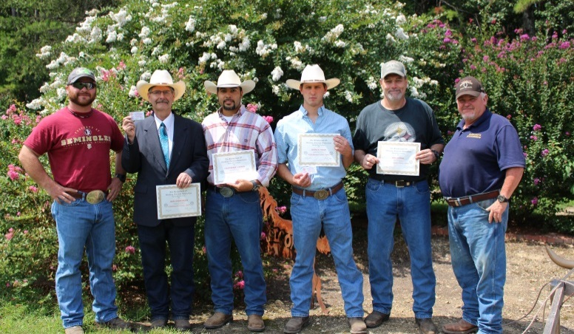
10
Getting Started
Registration – is easy !
The Application for Enrollment with cost, start dates and more info. is enclosed. Please call the office (or email) us first for available start dates. A small deposit is required to reserve your start date.
Entrance and Age Requirements
Persons physically able to perform these endeavors,
with mature attentiveness allowing safety for all.
High School Diploma or GED is suggested, but is not mandatory. Primarily English is spoken here.
Our age limit for Men is 18 and over. The parents or guardian of student’s ages 18-21 must visit and read and sign the enrollment agreement and liability release form. We can accept you on a 2 week trial basis first.
Our age limit for Ladies is 21 and over. (no exceptions)
Payments
The Balance will be due on the 1st day of class unless other arrangements have been discussed for part time students and part time payments.
Preferred methods of payment is
Personal or business checks, Cash, money orders, bank/cashier’s checks, etc.
Credit and Debit Cards, Visa and MC
Wire Transfers; bank to bank
Certification of Authorization We are a privately owned trade school recognized by the State of Georgia Nonpublic Post Secondary Education Commission.(NPEC) You will receive a certificate of completion…(.not to be confused with farrier certification available from a separate entity).
Financial Aid Options we can offer:
Veterans G.I. Bill, Voc. Rehab , Post 9/11
Financial Assistance : We can accept your outside sources like schools, clubs, Wounded Warriors, etc
Personal “Pay as you go” part time plan with us is the best financial plan we can offer,( not available at any other school).
NOT available are Government School Loans , Pell, Hope Grants and Federal & State WIA programs that require job placement
This is a private trade school providing education for your self-employment.

Slide 11
Housing & Meals
11
Our Tuition Fee is all Inclusive:
“Clean” Lodging & surroundings !
Separate facilities for men and women.
Available to you seven days a week.
You’ll need to bring things like:
Twin sized bed linens
Blankets, Pillows or sleeping bag
Personal toiletries
You will receive a list of more items when you submit your deposit
Shops & Coin Laundry are located nearby.
No pets allowed.
No smoking indoor any buildings.
You will be asked to read and sign an enrollment agreement required by the state.
AND…. home-cooked meals Hot breakfast & Lunch are served on class days as part of your tuition.
You will provide your own meals in the evenings and on off days (Sundays & Mondays)
Grocery stores are located nearby.
A refrigerator, microwave and outdoor grill are provided for student use, along with a TV/Study room.
Visitors Welcome!
Helpful Tips
For your safety, we recommend:
Good quality, sturdy boots
A tetanus shot
Warm clothing & extra boots during winter months.
We have indoor & outdoor facilities for all-weather shoeing and classroom activities all year’ round.
Tour our facilities
See classes in progress
Talk with current students
Meet the instructors
Owners can also learn A LOT about their horses
We ask that you call one day in advance to
schedule your visit !

Slide 12
12
Our Course Descriptions
You may attend
Full–time
Attend five days a week.
2, 6, or 12 weeks
Straight through.
2 weeks = 10 days
6 weeks = 30 days
12 weeks = 60 days
or
Part–time
Attend less than five days but over a longer period of time with a final goal of attending the 10 day,
30 day or
60 day course.
and
Saturday Only
is described as attending only one day a week if necessary with a final goal of attending a 10 day, 30 day, or 60 day course… the same as a part-time student.
We are the only School that allows a flexible class schedule like this and PROUD OF IT !
Horseshoeing I Two weeks (10 days): A great Introductory Course ! These are the first two weeks of all courses: We begin with safety first, while handling and being underneath horses. Whether you are a horse owner with a few horses, barn manager with a herd or may be considering to continue into this as a career, these first two weeks are crucial in understanding the REASON and PURPOSE of trimming, shoeing, overall hoof care and safety !
Training in class, by shoeing live horses from the first day, learning the necessary shoe shaping and forging techniques. (This course is NOT intended for you to go out and shoe for the public and not VA approved.)
Horseshoeing II Six Weeks (30 days): The first two plus four more. You will receive the equivalent of an eight week course in our six weeks here, allowing you to spend a shorter time away from home. You will learn how to change the horse's mode of travel caused by poor leg and hoof conformation or previous improper shoeing, how to recognize, prevent and correct lameness, in depth study of the anatomy related to proper balance and shoeing of all breeds and types of horses. You will learn to handle spoiled horses, basic horse psychology, how to set up your own business and shoeing rig, receive BUSINESS STRATEGY LECTURES, classroom time and extensive live shoeing and forging.
Horseshoeing III Twelve Weeks (60 days): The first six plus six more. This course prepares the student further to be a professional farrier. After the six week course you will concentrate your time on perfecting your techniques with more corrective techniques, welding, lameness issues, nutrition and an excellent anatomy EFT course. Setting up your rig, more tools and business topics. You will work with the professional staff farriers with the Farriers’ National Research Center. You will be expected to perform more physically and become better in decision making and client relationships.. We also provide two options of tool plans for you to choose from.
Horseshoeing IV Advanced - Additional Six Weeks (30 days): Over and above your beginner 12 week course you can immediately enter into this course or after shoeing on your own for several months. This course offers you the opportunity to now specialize and apprentice to continue your education even further. Please see the enclosed description & on line.
Trim Class – We are the only school to offer this for the horse owning public.
This one/two day course is for horse owners who want to learn to trim their own by bringing their horses with them to class. You will receive the same excellent hands-on training that all students receive their first days. We are helping you, the owner, understand hoof care knowledge and horsemanship under the horse, using sharp tools, the difference in trimming to remain barefoot vs for shoeing with safety for you both in mind. This could be your “trial” day for further education or just trim your own.
If you already have some experience trimming or shoeing, work as an apprentice, need valuable hot forge work or have been shoeing for many years you are welcome here ! A visit or your first week in class will determine your length of stay as you are working at your own pace to achieve just want you need.

Slide 13
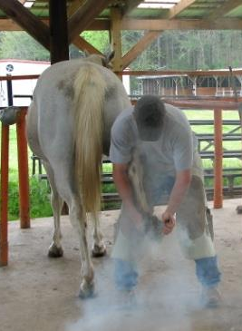
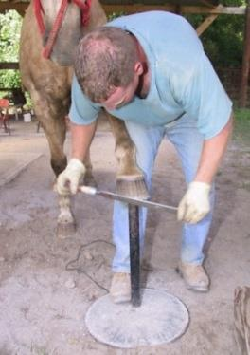
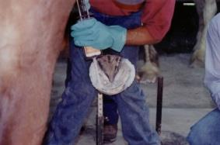
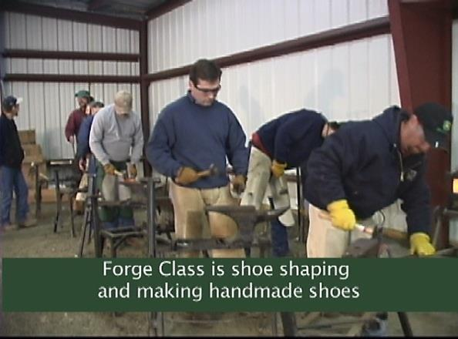
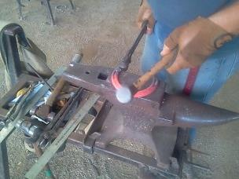
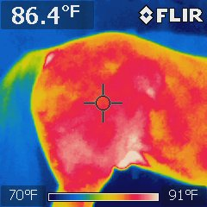
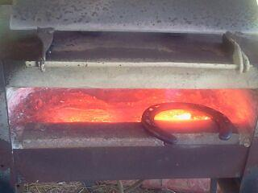
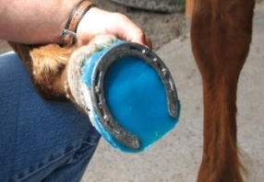
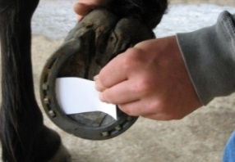
Course Curriculum
13
LIVE SHOEING WITH LIVE HORSES !! (50%)
Each course begins with our “6 Steps Grammar School of Trimming and Shoeing Horses" and follows through daily on every horse.
Horsemanship & Horse Psychology Variety of Equine Breeds available
Anatomy of the whole horse
Bones of the Front and Hind Limb
Hoof Structures
Determining the Angle of the Hoof
Shoe and Nail Sizes
Serious Hoof Problems of all types
Aging the Horse
Properly Balancing
Correctly Driving Nails
Clinching Nails, Finishing
Evaluating & Lameness of the Hoof
Traveling Problems and Correction
Correct arising problems: Cracks,
Splits, Hoof Loss, Bonding, Pads,
Glue-on, keeping up with progress,
Choosing and using the hand tools
Infrared Thermal Imaging, Treadmill, Track. CaseyCam and
Equine Flexion Therapy only found at this school !
Shop: Gas Forge work & Blacksmithing: (40%)
(referred to as Hot, cold, corrective and hand made shoes)
Every shoe is “fit to the foot.”
Flattening, Mounting, Centering, punching, tricks with heat,
Handmade shoes of most popular styles used, steel, aluminum
Cold is shaping factory made shoes on the anvil.
Hot Shoeing refers to Forge work when shaping the shoe while hot using propane gas forges and hot shoeing refers to ensuring a level flat hoof. We modify factory made (keg) shoes into corrective shoe shapes and make hand made shoes from bar stock for corrective shoeing. We use arc welding and other industrial equipment to aid and improve our skills.
CLASSROOM Time (10%)
Daily as needed. Study Resources available, DVD’s, Business Lectures, Guest Farriers monthly.
TESTING: is based on all of the above, written & orally one-on-one during your schooling to prepare for successful graduation.
Horsemanship and SAFETY: We highly promote and teach safety measures handling horses to avoid injuries to students or horses. Students and owners are asked to sign a liability release form.

Slide 14
14
Farrier Tools You Will Need
We provide a NEW start-up package of hand tools for purchase. We sell a variety of popular farrier brand names. The current price list is enclosed and cost on the Application. Loaner tools are made available for a small user fee (or bring tools you may have) as of 3.1.2019
2 Day Trim Students
are asked to purchase:
Rasp with handle
Hoof Knife
Wire Brush
You may use our “loaners” or purchase:
Hoof Nippers
Farrier Apron
Hoof Gauge, and misc.
Our DVD & Booklet are included in the tuition.
We ask Trim Only Students
to bring their own horses
to trim ! Learn to handle and trim for your specific needs depending on the breed and activity of your horses.
2 Week Students
Farrier Apron
Aluminum Shoeing Box
15” or 14” Hoof Nippers
Saddle Horse Clinchers
Shoe Pullers
Clinch Cutter
14oz. Driving Hammer
36oz. Rounding Hammer
1 Rasp with Handle
Hoof Knife
Sharpener
Crease Nail Puller
Handled Wire Brush
Center punch
Clinch Block
Our manual
School DVD
6 week & 12 Week Students: Option 1
Farrier Apron
Aluminum Shoeing Box
15” or 14” Hoof Nippers
Saddle Horse Clinchers
Shoe Pullers, Clinch Cutter
14oz. Driving Hammer
36oz. & 24oz Rounding Hammers
2 Rasps with Handles
Hoof Knife & Sharpener
Clinch Block, Fire Tongs
Crease Nail Puller
Handled Wire Brush
Center Punch, Pritchel, Forepunch & Creaser
Hoof Gauge & Divider
Our manual
School DVDs
12 week: Option 2
Tool Package includes all of option 1 plus:
Anvil , Stand, EFT Tools
6 week ADVANCED Course Tools:
Forge and forge tools
Using & Choosing your hand tools is part class

Slide 15
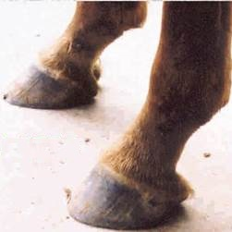
15
Frequently Asked Questions
Q: I work during the week and only have weekends off. Can I attend your school only on Saturday?
A: Yes, you may attend any course on the weekends until you complete the designated number of days for that particular course. After you make your initial deposit you may pay by the day.
Q: I can only get 2 weeks off work now, but can get more time off later; can I split up my time in school?
A: Yes, If you have only time or finances for a two week course now, you may return at a later date and complete another four weeks for a total of six weeks and just pay the difference between the tuitions. The same goes for the 6 and 12 weeks course. You will not be starting all over again, just continuing your education.
Q: What is the difference between the 6 and 12 week courses?
A: From a student's point of view, at 6 weeks you feel you have a good grasp of shoeing, after 12 weeks you are much more confident, your blacksmithing and decision making is helping you gain more knowledge.
At 12 weeks, students are much more capable of catering to the “Full Service” needs of their clients.
In 12 weeks you have the chance to see how your work held up as you are able to critique the work when the horses you shoe return. Most horses need more than just a simple shoeing. 6 weeks student just get the tip of the iceberg when it comes to dealing with founder, white line disease, abscesses, hoof wall cracks, missing hoof wall and the opportunity to address such problems using some of the latest technologically advanced products. It is easier for a 12 week student to make the transition between shoeing in a sheltered school environment where there are plenty of people to aid you and when you are completely on your own dealing with an unruly horse, a demanding client or troubleshooting an unfamiliar shoeing situation.
Taking Proper Care Of A Horses Hooves.. Before and After
Upon Arrival
A Club Foot
6 Month Old Colt
Normal Angles at One Year
8 Months Later
Polo Horse Before
6 Months Later

Slide 16
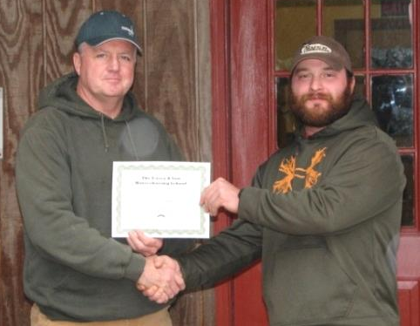
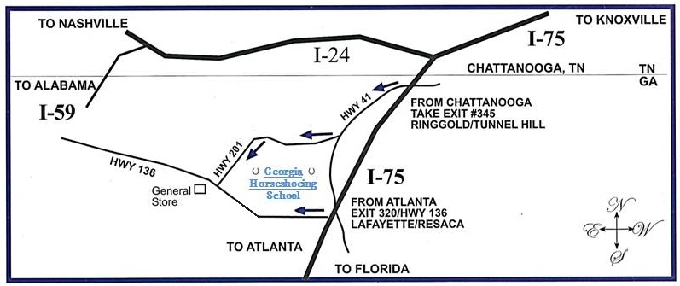
16
Our Students Say It Best!
14013 E. Hwy. 136
La Fayette, GA 30728
(706) 397-8909
rcaseysch@aol.com
www.caseyhorseshoeing.com
www.caseyhorseshoeingschool.com
www.georgiahorseshoeingschool.com
School Days & Visiting:
Tuesday-Saturday
8am - 5pm
Office & Phone Hours:
M-F 8am 5pm
Sat 8am – noon
"I have been apprenticing with a farrier for a few years. I needed more formal instruction and this school was tailored to my personal needs. Link Casey, was excellent at conveying his expert knowledge and teaching abilities.“
-Rod Witherite of West Milton, PA
with Link Casey (right)
“When I completed my military career I used my Post 9/11 funding to attend the 12 week course and the Advanced Course.. With no prior experience I feel confident at beginning my new farrier career to support my family.”
-Ty Harden of Montana
Did you know?
A Certified Farrier
Can Earn
$50,000 to $100,000
Per Year!
Our Location:
From Atlanta, Georgia: I-75 North to Exit #312, Calhoun/Fairmount /Hwy 53 (the best exit)
This is your last exit full of shopping and eating places. At the exit ramp, turn left and begin counting traffic lights.
When you reach the 10th light (after 2 miles) take the right turn only onto S. River Street. *The 35 mph speed limit is enforced This turns into Hwy 136 West. Stay on Hwy 136 for 18 MORE miles (for a total of 20)
The school and horse head sign with an American Flag flying will be on the right
Casey & Son, Farriers’ National Research Center and School
From Chattanooga, Tennessee: I-75 South to Exit #345, Ringgold/Tunnel Hill /Hwy 41 (the best exit)
At the exit ramp, turn right and go through Tunnel Hill, approximately 10 miles.!
You will approach a Traffic Light and a right turn only
Turn Right onto Hwy 201. You will see a sign to Villanow, 12 miles.
At Villanow, the General Store will be in front of you at the intersection/stop sign.
Turn left onto Hwy 136 going East and drive 1.5 miles
The sign with American Flag flying will be on the left: Farriers’ National Research Center and School

